Slide 1




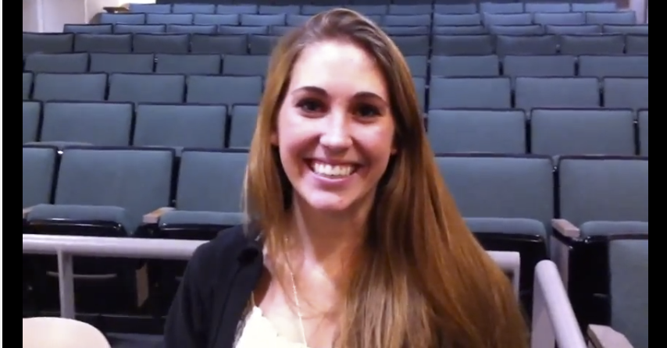
BJC: you’ll love it! Hard work, but fun!
The Beauty and Joy of Computing Lecture #1 Welcome; Abstraction
Jon McKinsey
Watch the student testimonials about the course, what it means to them, and how it has changed their lives. It’s quite Inspiring!
Michael Ball
cs10.org

Slide 2

Computing in the News: BJC4NYC
We’re working with the NYC school district to bring BJC to 100 NYC teachers by 2020!
We were just mentioned by White House!
bjc.link/bjcwhitehouse

Slide 3

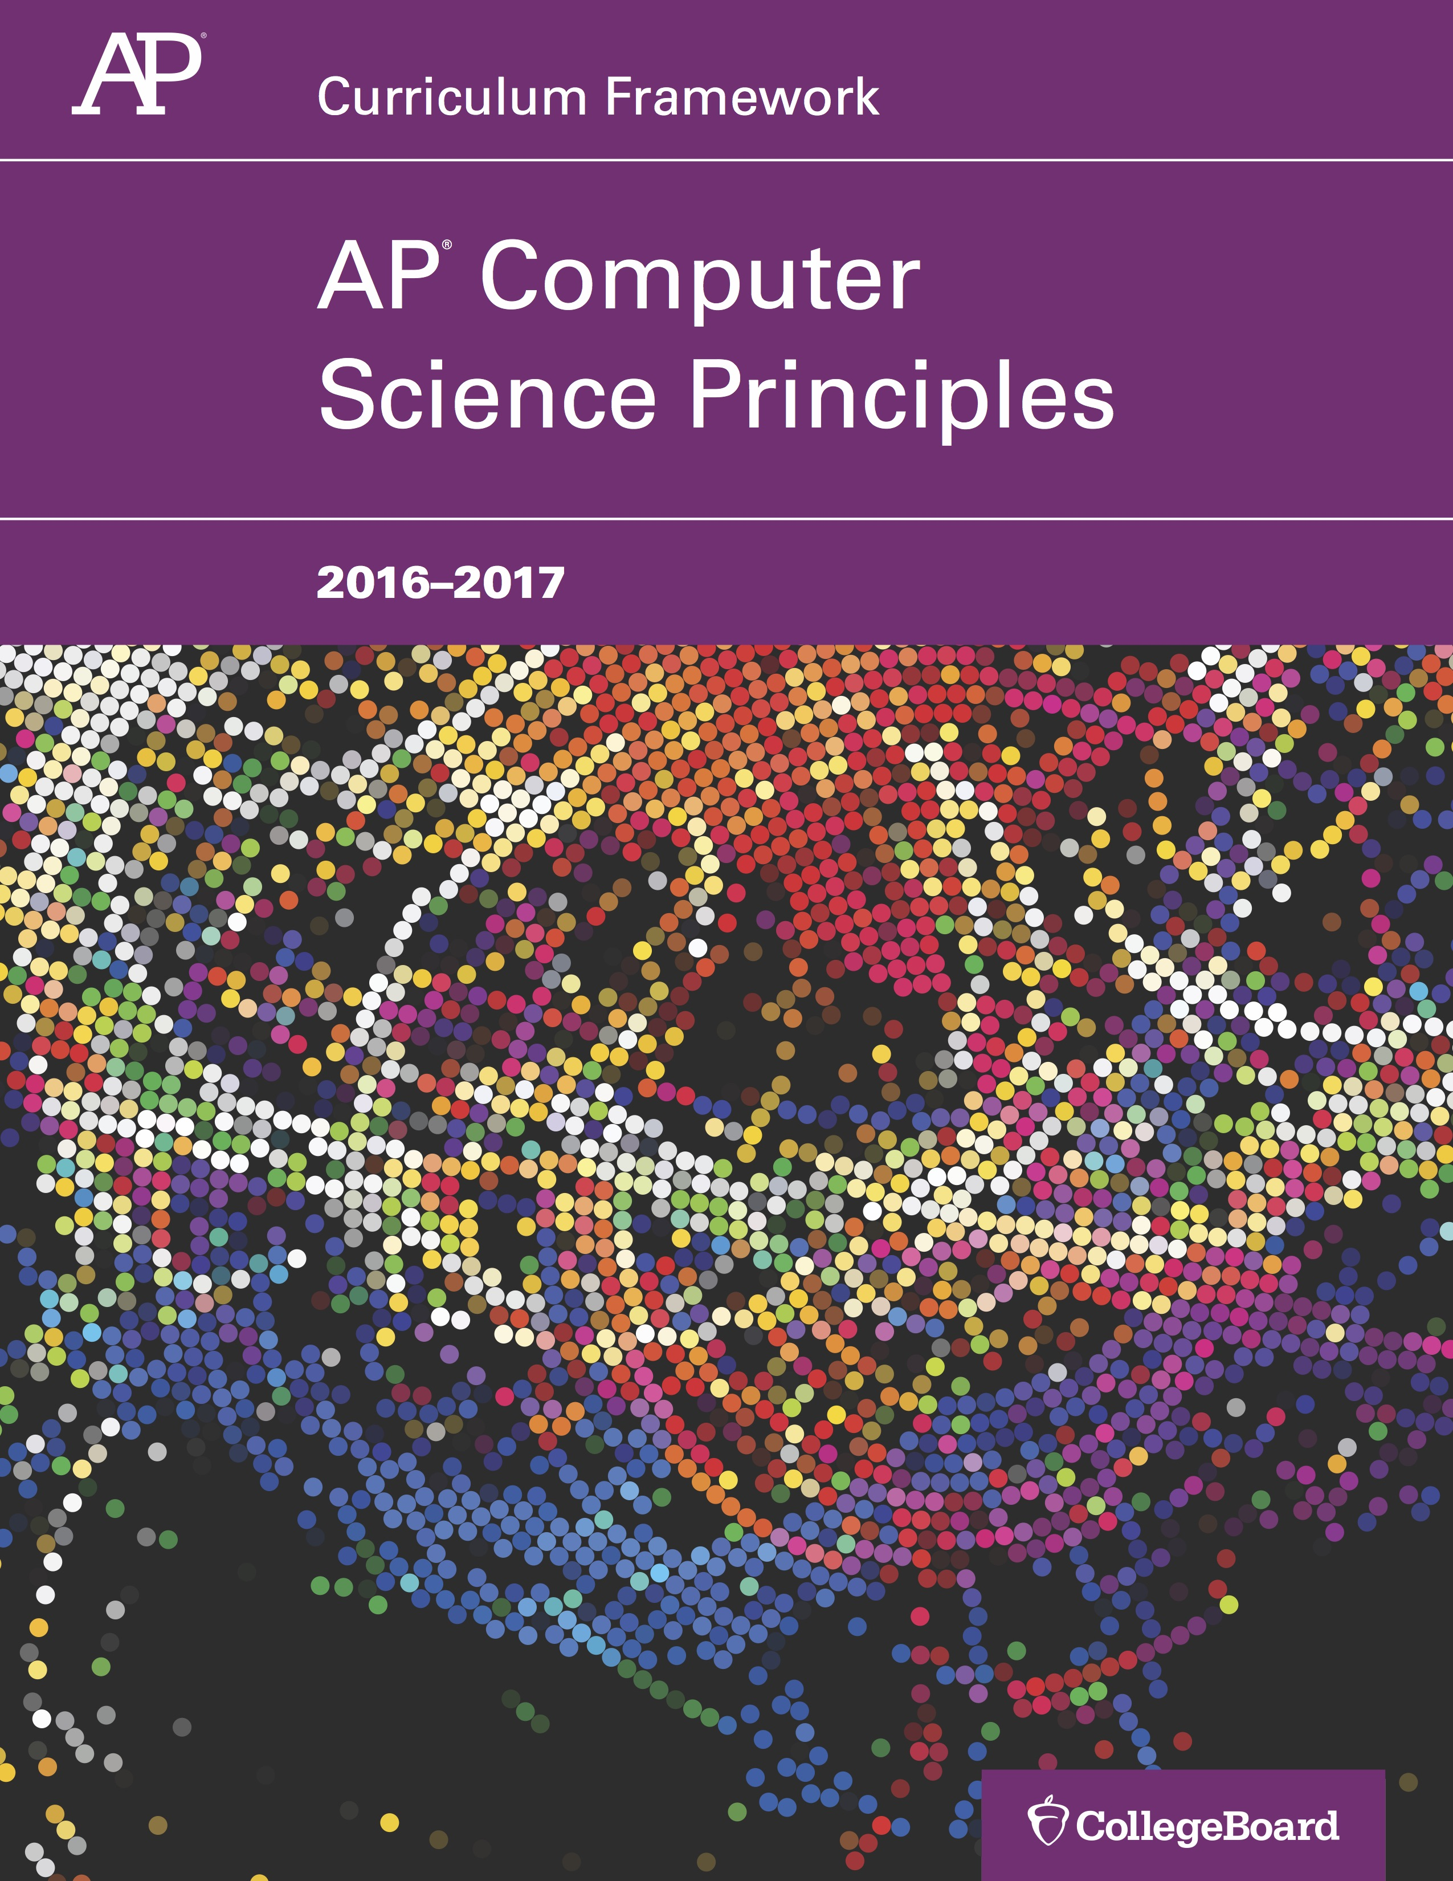
(AP) Computer Science Principles
7 Big Ideas
Creativity
Abstraction
Data and Information
Algorithms
Programming
The Internet
Global Impact

Slide 4
(AP) Computer Science Principles
6 Computational Thinking Practices
Connecting computing
Creating computing artifacts
Abstracting
Analyzing problems & artifacts
Communicating
Collaborating

Slide 5
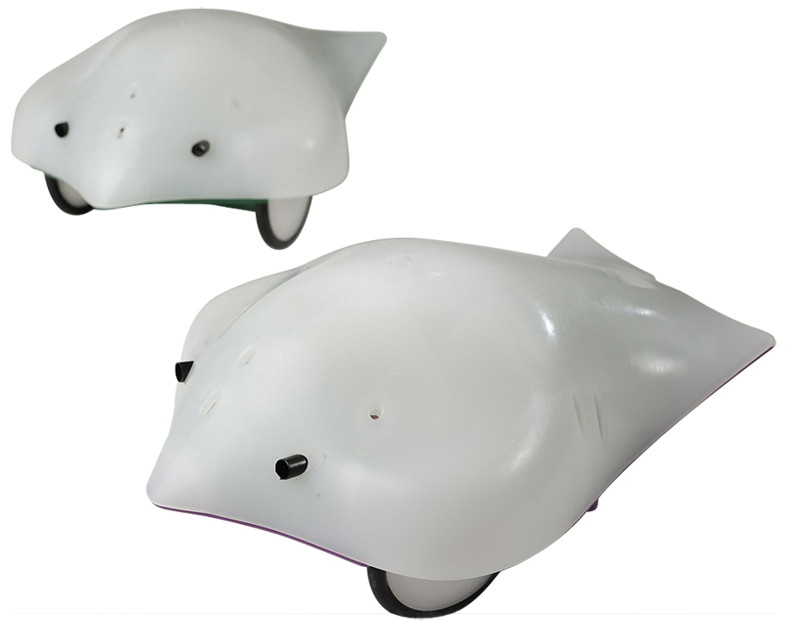
Beauty and Joy of Computing in one slide
Big Ideas of Programming
Abstraction
Algorithms (2)
Recursion (2)
Functions-as-data, l (2)
Programming Paradigms
Cloud Computing
Beauty and Joy
“CS Unplugged” activities
If f2f, all lab work in pairs
“Create” performance task
Of your own choice!!
“Explore” performance task
Of your own choice!!
Big Ideas of Computing
Daily “computing in the news”
How the Internet works
Research Summaries
AI
HCI
The Power of Data (big, small)
Social Implications of Computing
Saving the World w/Computing
Cloud Computing
Limits of Computing
Future of Computing
Robots…

Slide 6

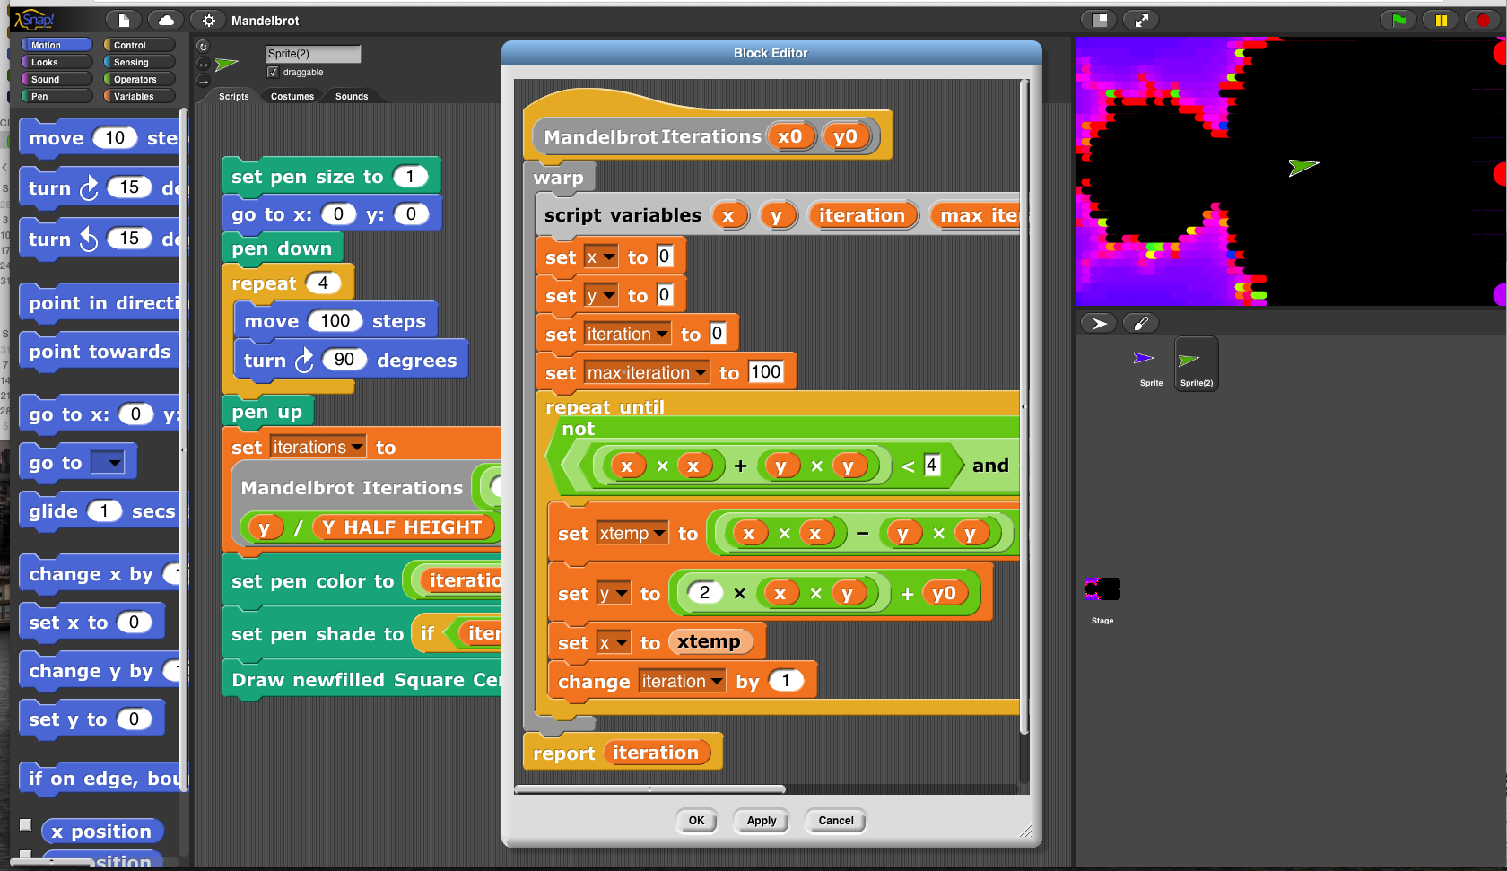

Incredibly easy-to-learn coding in
☑

Slide 7

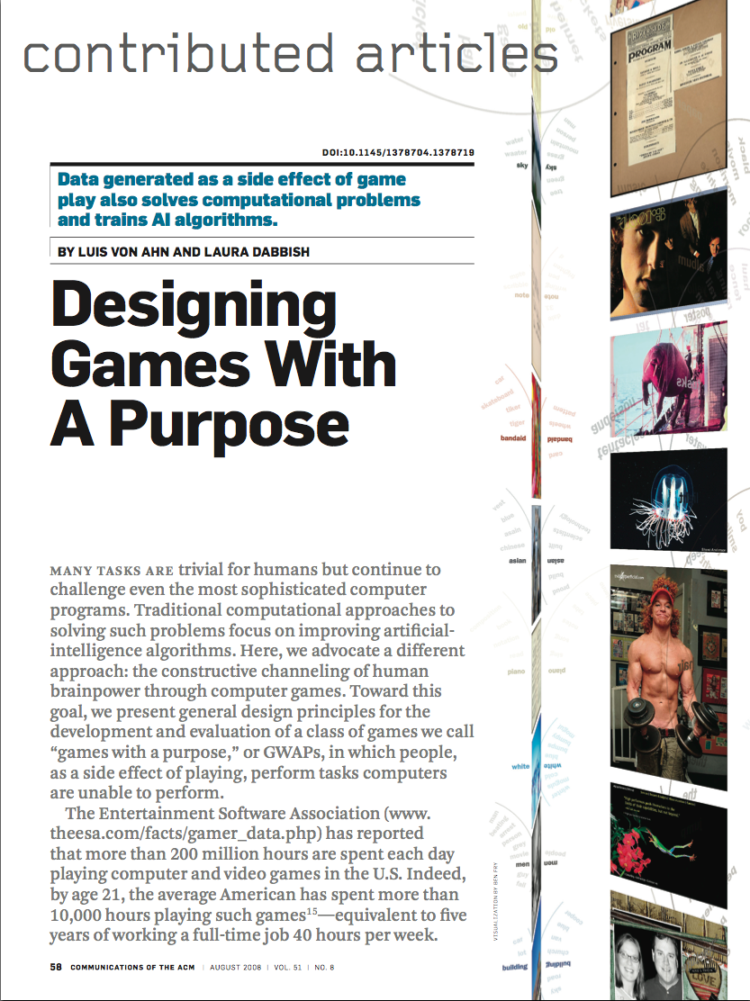
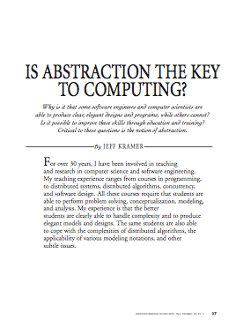
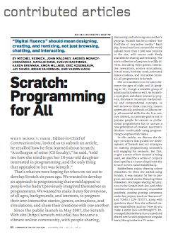
Format & Textbooks
Format (14 hrs/wk * 7 wks)
See the following slides
Selected Reading
Taken from book (“Blown to Bits” by Abelson, Ledeen & Lewis) + articles + videos
Current events EVERY LECTURE (e.g., IBM’s Watson vs Jeopardy)
All resources FREE
Even clickers!
Pair Programming!
…

Slide 8
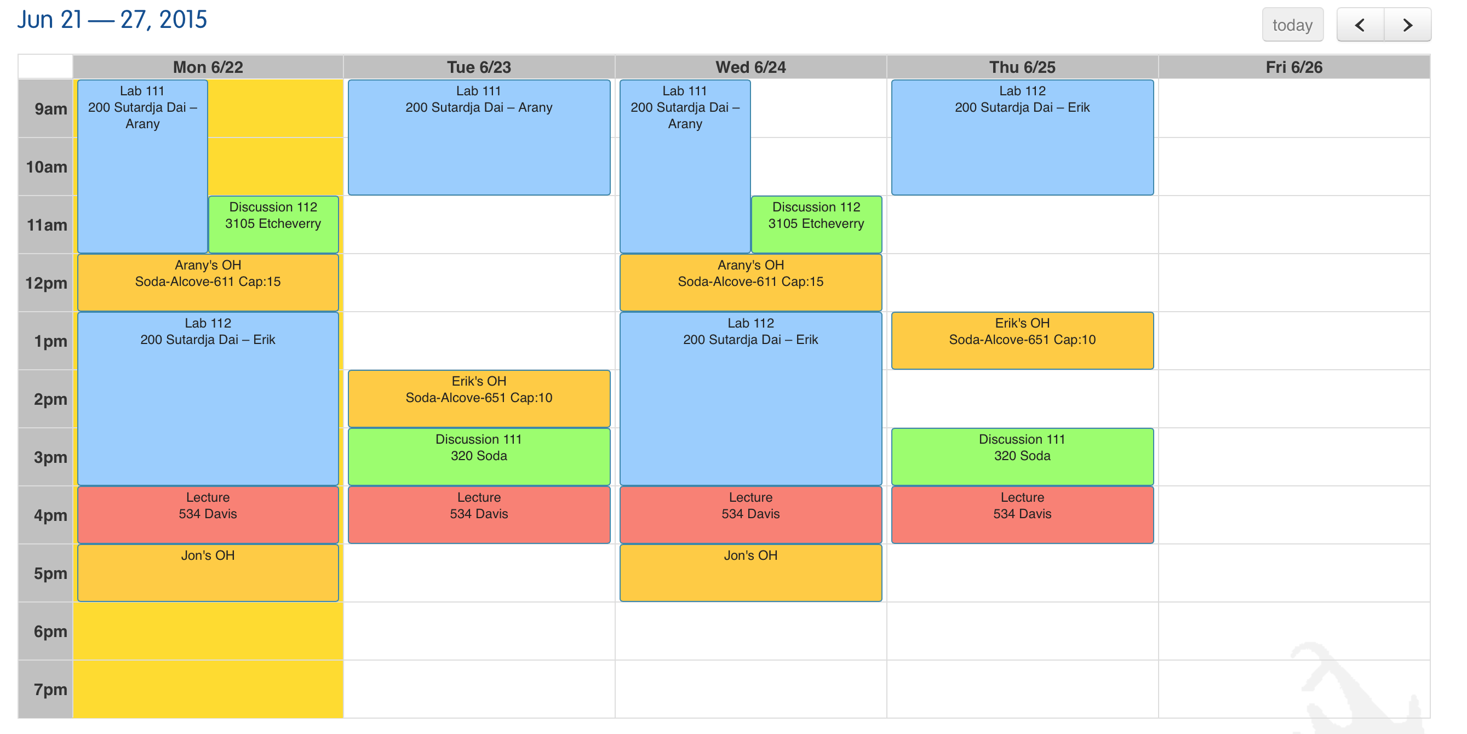
Weekly Schedule (on cs10.org)

Slide 9
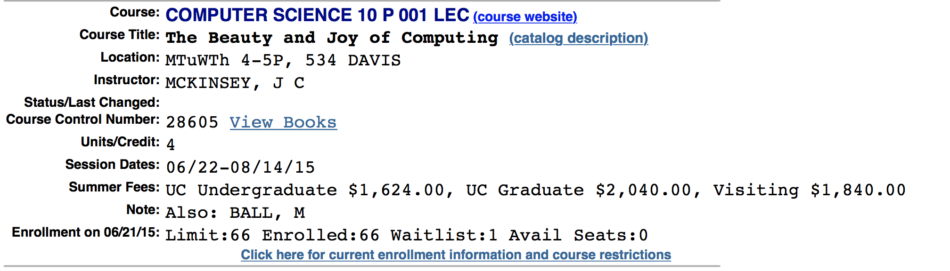
Let’s check enrollments…
We have NEVER turned anyone away, and we don’t intend to turn anyone away this semester!

Slide 10

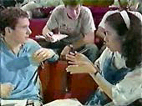
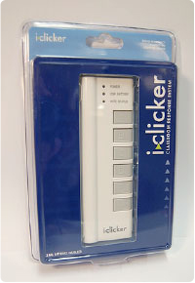
Peer Instruction for active learning!
Increase real-time learning in lecture, test understanding of concepts vs. details
As complete a “segment” ask multiple choice question
1-2 minutes to decide yourself
2 minutes in pairs/triples to reach consensus. Teach others!
2 minute discussion of answers, questions, clarifications

Slide 11
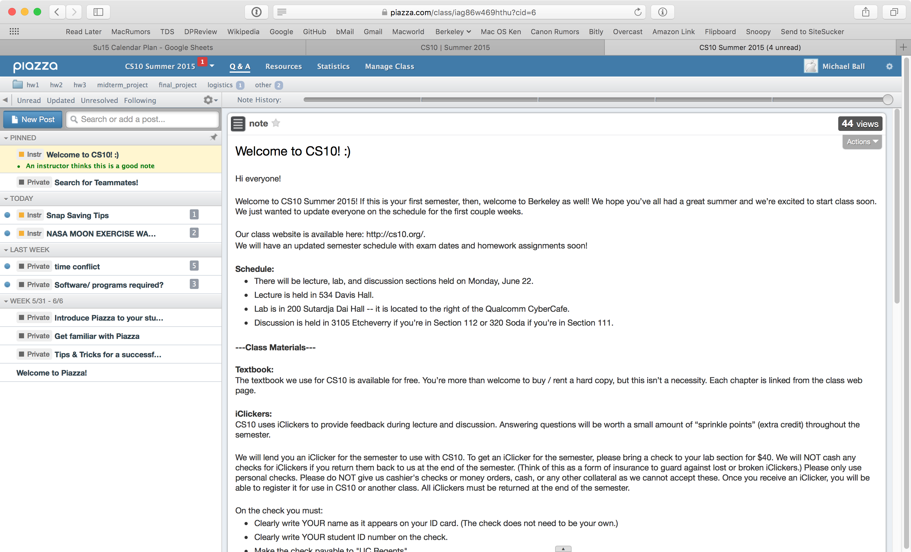
Piazza: Q&A, Help, Announcements

Slide 12
Pro-student Grading Policies
EPA
Rewards good behavior
Effort
E.g., Office hours, doing every single lab, hw, reading Piazza pages
Participation
E.g., Raising hand in lec or discussion, asking questions on Piazza
Altruism
E.g., helping other students in lab, answering questions on Piazza
You have 3 “Slip Days”
You use them to extend due date, 1 slip day for 1 day extension
You can use them one at a time or all at once or in any combination
They follow you around when you pair up (you are counted individually)
E.g., A has 2, B has 0. Project is late by 1 day. A uses 1, B is 1 day late
Late is 1/3 off/day
☑

Slide 13
Abstraction & Detail Removal

Slide 14
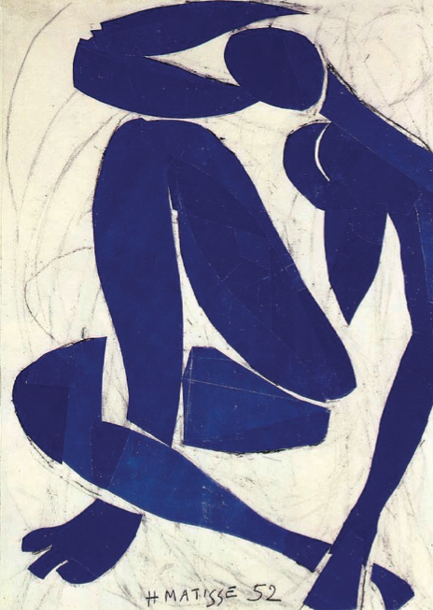
Abstraction
Detail removal
“The act or process of leaving out of consideration one or more properties of a complex object so as to attend to others.”
Generalization
“The process of formulating general concepts by abstracting common properties of instances”
Naked Blue IV (Henri Matisse, 1952)

Slide 15
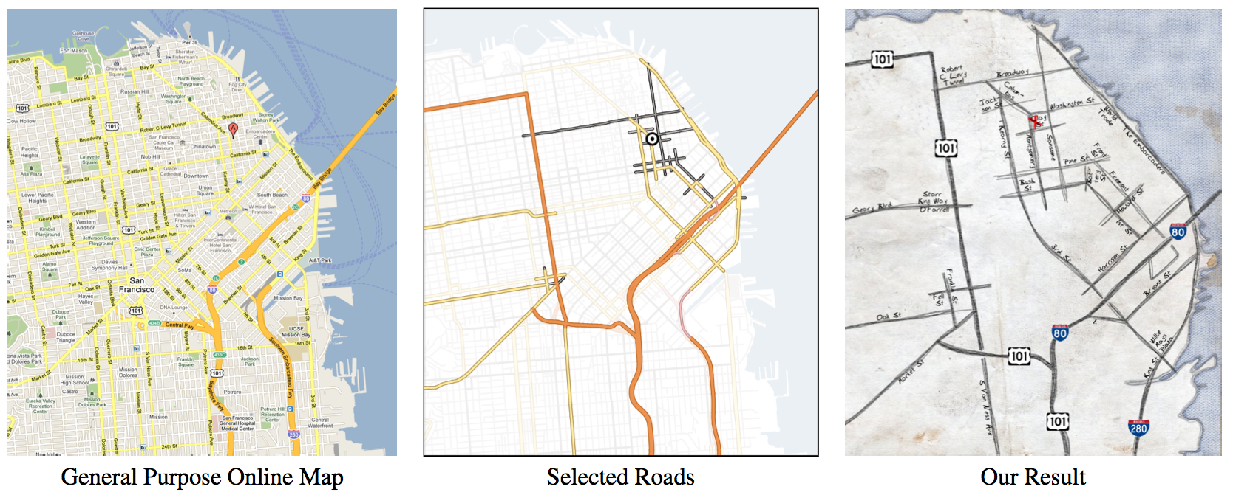
Detail Removal
Automatic Generation of Detail Maps (Maneesh Agrawala @ UC Berkeley, among others)

Slide 16
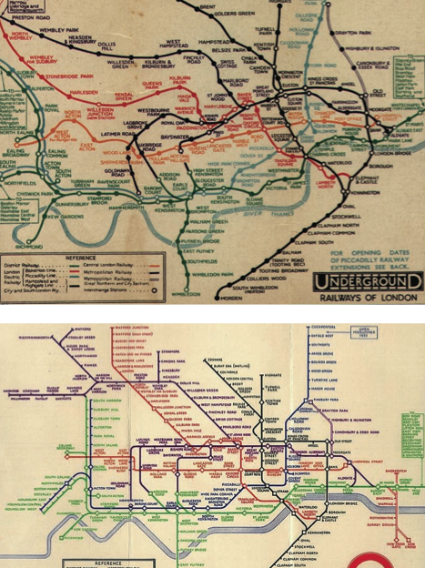
Detail Removal (in BJC)
You’ll want to write a project to simulate a real-world situation, or play a game, or …
Abstraction is the idea that you focus on the essence, the cleanest way to map the messy real world to one you can build
Experts often brought in to know what to remove and what to keep!
The London Underground 1928 Map & Harry Beck 1933 map.
☑

Slide 17
Generalization

Slide 18
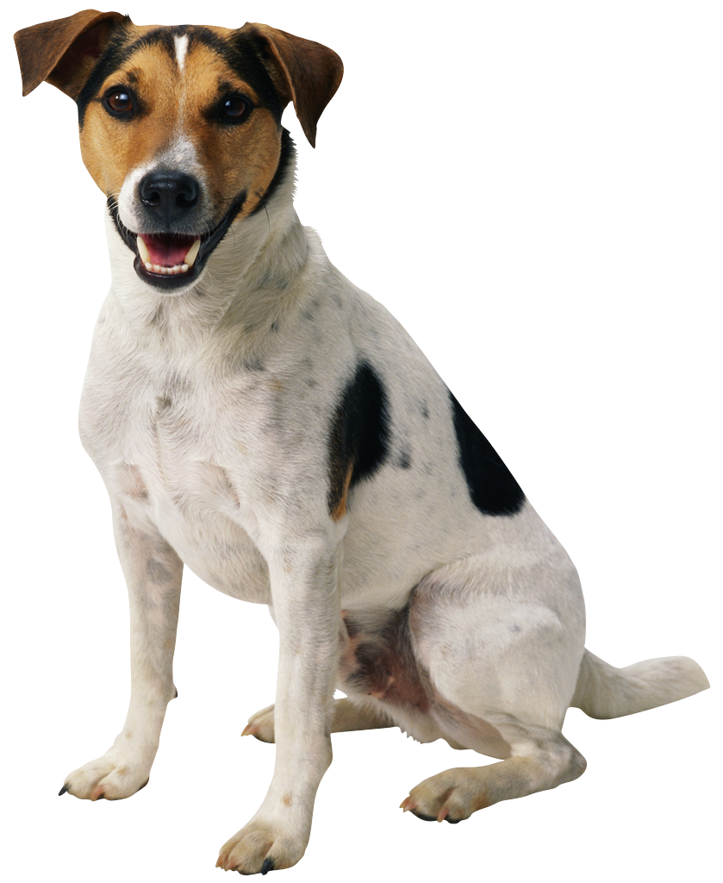
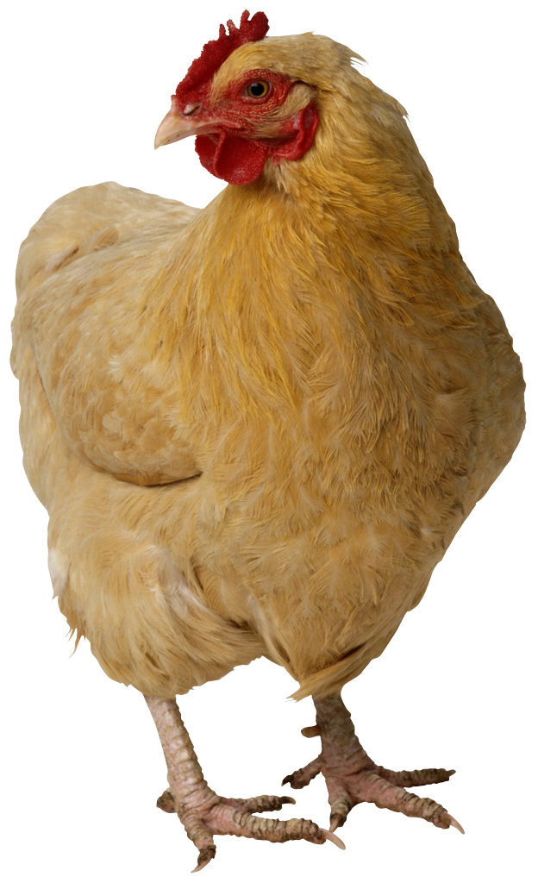
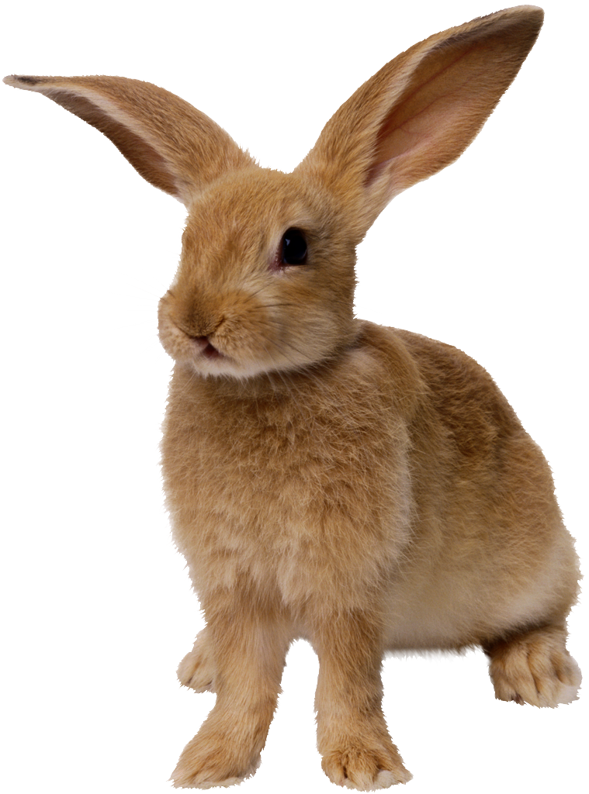
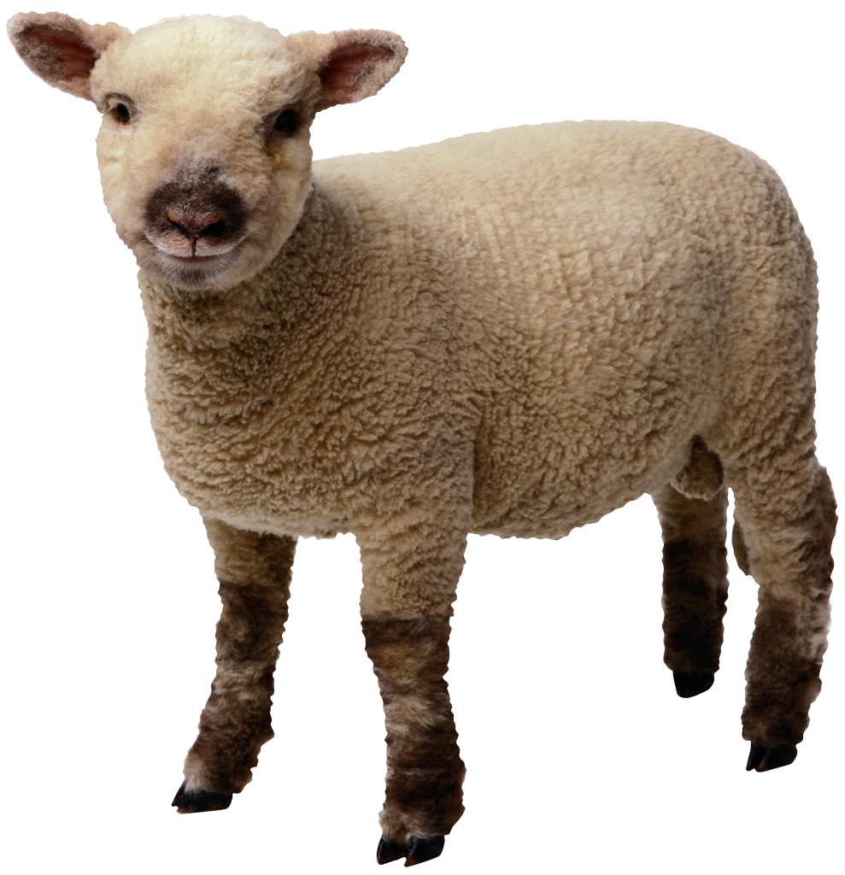
Generalization Example
You have a farm with many different animals.
Different food for each
You have directions:
To feed dog, put dog food in dog dish
To feed chicken, put chicken food in chicken dish
To feed rabbit, put rabbit food in rabbit dish
Etc…
How could you do better?
To feed <animal>, put <animal> food in <animal> dish

Slide 19
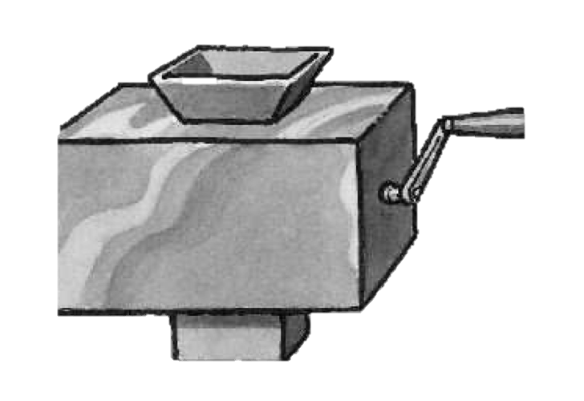
Generalization (in BJC) … foreshadowing
You are going to learn to write functions, like in math class:
y = sin(x)
You should think about what inputs make sense to use so you don’t have to duplicate code
Function machine (Simply Scheme, Harvey)
☑

Slide 20
Abstration Interfaces & Summary

Slide 21
The Power of Abstraction, everywhere!
Examples:
Functions (e.g., sin x)
Hiring contractors
Application Programming Interfaces (APIs)
Technology (e.g., cars)
Amazing things are built when these layer
And the abstraction layers are getting deeper by the day!
We only need to worry about the interface, or specification, or contract
NOT how (or by whom) it’s built
Above the abstraction line
Abstraction Barrier (Interface) (the interface, or specification, or contract)
Below the abstraction line
This is where / how / when / by whom it is actually built, which is done according to the interface, specification, or contract.

Slide 22
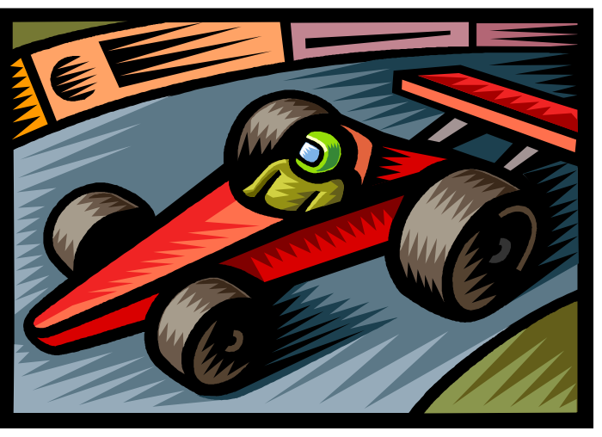
Summary
Abstraction is one of the big ideas of computing!
It’s how mankind has engineered some of the greatest structures and managed the complexity
Two definitions
Detail Removal
Generalization
Someone who drove in 1930 could still drive a car today because they’ve kept the same Abstraction!
(right pedal faster, left pedal slow)
☑

